Slide 1

GROCERY STORE MANAGEMENT
Presented by
- O.Rahul
- K.Sai Anirudh
- S.Rajashekar
- V.Mounish kumar

Slide 2
Agenda
Introduction
Problem Statement
Objective of the Project
ER Diagram and schema explanation
About Tables
Key analysis questions (use cases)
SQL query results with screenshots or summaries
Final business insights and recommendations
Conclusion (Key finding overall)
Q&A Slide
Your Experience/Challenges working on SQL – Data Analysis Project.

Slide 3

INTRODUCTION

Slide 4


Slide 5

Objective
In this project, I created a mini grocery store database using MySQL to manage products, suppliers ,customers , and orders.
The main objective of this project is to design and implement a mini grocery store database using MySQL that efficiently manages products, suppliers, customers, employees, and orders.
It aims to track sales, monitor inventory, analyze customer activity, and improve overall business decision-making through data-driven insights.

Slide 6
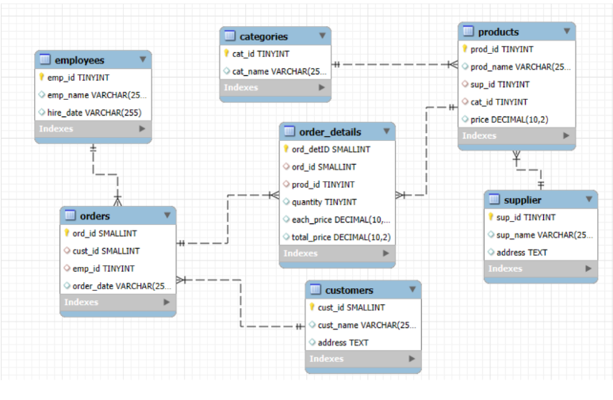
ER Diagram and schema explanation

Slide 7
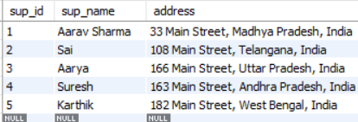
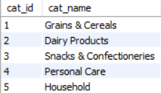
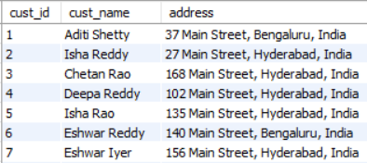
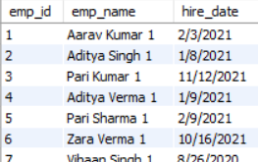
ABOUT TABLES
Suppliers
Categories
Customers
Employees

Slide 8
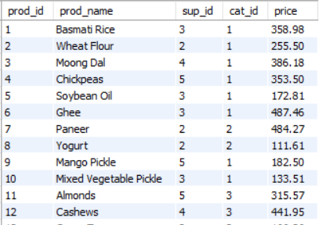
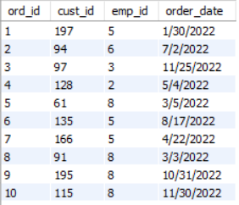
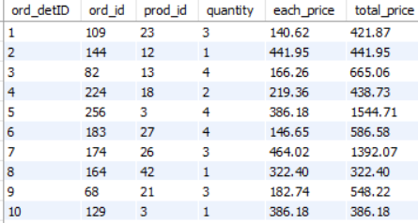
Products
Order details
Orders

Slide 9
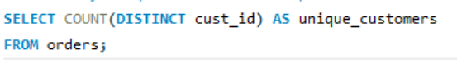
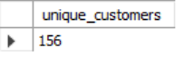
CUSTOMER INSIGHTS How many unique customers have placed orders?
QUERY
DESCRIPTION :
This query counts the total number of unique customers who have placed orders. It uses COUNT(DISTINCT cust_id) to ensure that each customer is counted only once, even if they placed multiple orders. The result gives the total customer base reflected in the orders table.
OUTPUT

Slide 10
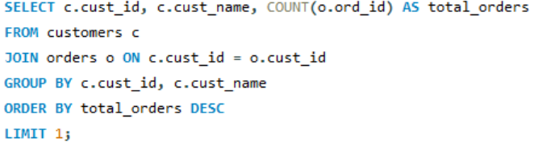
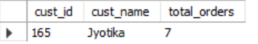
Which customers have placed the highest number of orders?
QUERY
DESCRIPTION :
This query identifies the customer who has placed the highest number of orders. It joins the customers and orders tables, groups data by customer, counts their orders, and then sorts in descending order. Finally, LIMIT 1 returns only the top customer with the most orders.
OUTPUT

Slide 11
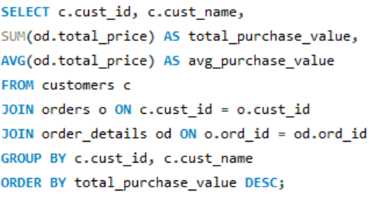
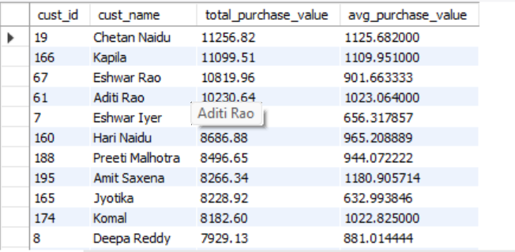
What is the total and average purchase value per customer?
QUERY
DESCRIPTION :
This query identifies the customer who has placed the highest number of orders. It joins the customers and orders tables, groups data by customer, counts their orders, and then sorts in descending order. Finally, LIMIT 1 returns only the top customer with the most orders.
OUTPUT

Slide 12
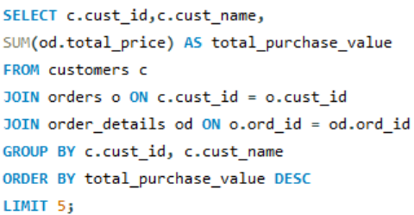
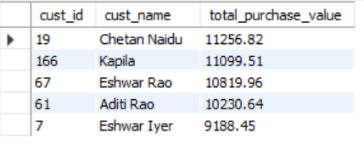
Who are the top 5 customers by total purchase amount?
QUERY
DESCRIPTION :
This query finds the top 5 customers based on their total purchase amount. It joins customers, orders, and order details, calculates the total spending of each customer using SUM, groups results by customer, and then orders them in descending order to display the five highest spenders.
OUTPUT

Slide 13
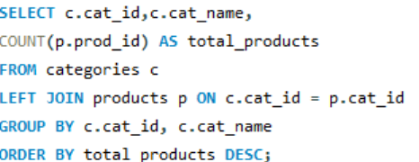
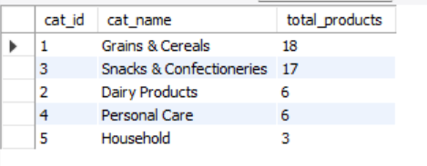
PRODUCT PERFORMANCE
How many products exist in each category?
QUERY
DESCRIPTION :
This query shows the number of products in each category. It joins categories with products, counts the products per category using COUNT, and groups the results by category. A LEFT JOIN ensures even categories without products are included, and the output is sorted by the highest product count.
OUTPUT

Slide 14
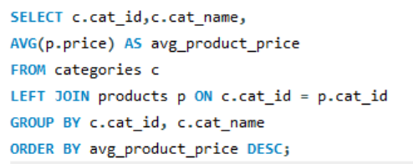
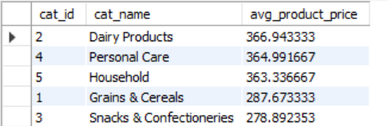
What is the average price of products by category?
QUERY
DESCRIPTION :
This query calculates the average product price for each category. It joins categories with products, uses AVG to find the mean price of products in every category, groups results by category, and sorts them in descending order of average price.
OUTPUT

Slide 15
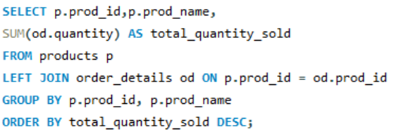
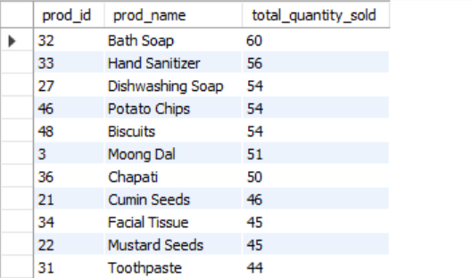
Which products have the highest total sales volume (by quantity)?
QUERY
DESCRIPTION :
This query identifies the top-selling products by quantity. It joins products with order details, sums up the total quantity sold for each product using SUM, groups results by product, and orders them in descending order to highlight the highest sales volumes.
OUTPUT

Slide 16
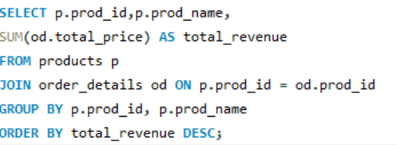
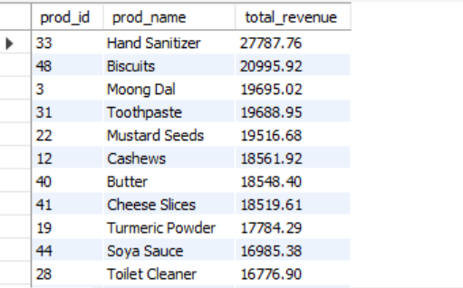
What is the total revenue generated by each product?
QUERY
DESCRIPTION :
This query calculates the total revenue generated by each product. It joins products with order details, sums up the total_price for all sales of each product, groups results by product, and orders them in descending order to show the highest revenue-generating products first.
OUTPUT

Slide 17
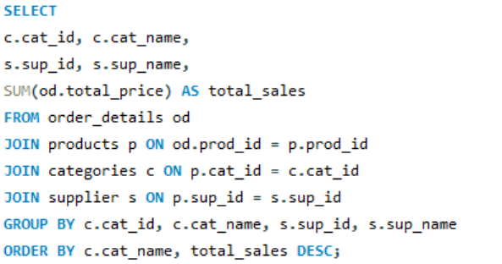
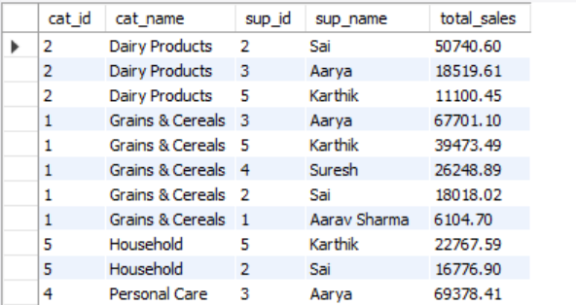
How do product sales vary by category and supplier?
QUERY
DESCRIPTION :
This query shows the total sales generated by each supplier within every category. It joins order details with products, categories, and suppliers, then calculates sales using SUM(total_price). Results are grouped by both category and supplier, and finally ordered by category name and sales in descending order.
OUTPUT

Slide 18
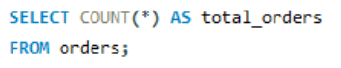
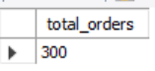
Sales and Order Trends
How many orders have been placed in total?
QUERY
DESCRIPTION :
This query returns the total number of orders placed. It uses COUNT(*) on the orders table to count all rows, giving the overall number of orders recorded in the system.
OUTPUT

Slide 19
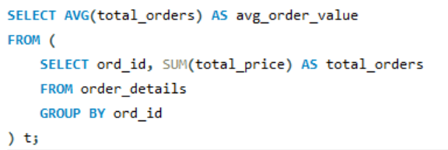
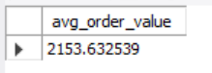
What is the average value per order?
QUERY
DESCRIPTION :
This query calculates the average value per order. It first computes the total value of each order by summing total_price for every ord_id, then takes the average of these totals using AVG. The result represents the typical purchase amount per order.
OUTPUT

Slide 20
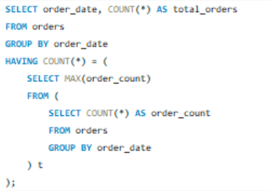
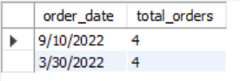
On which dates were the most orders placed?
QUERY
DESCRIPTION :
This query returns the date(s) with the maximum number of orders by grouping orders by date, counting them, and filtering only the date(s) with the highest order count.
OUTPUT

Slide 21
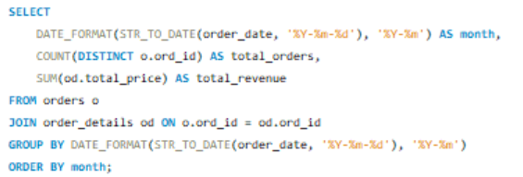
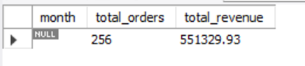
What are the monthly trends in order volume and revenue?
QUERY
DESCRIPTION :
This query shows the monthly trends in order volume and revenue. It groups orders by month, counts the total number of orders, calculates total revenue using SUM(total_price), and then displays the results in chronological order.
OUTPUT

Slide 22
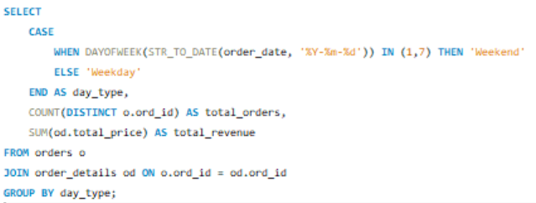
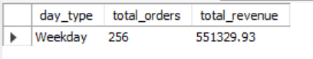
How do order patterns vary across weekdays and weekends?
QUERY
DESCRIPTION :
This query compares weekend vs. weekday order trends. It classifies each order date as either Weekend or Weekday, then counts total orders and sums up total revenue for each category.
OUTPUT

Slide 23
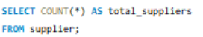
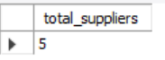
Supplier Contribution
How many suppliers are there in the database?
QUERY
DESCRIPTION :
This query returns the total number of suppliers in the database by counting all rows in the supplier table.
OUTPUT

Slide 24
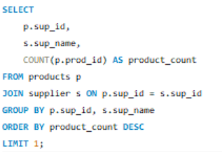
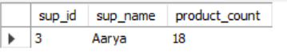
Which supplier provides the most products?
QUERY
DESCRIPTION :
This query identifies the supplier offering the most products. It counts the products linked to each supplier, groups by supplier, and orders them in descending order, returning only the top supplier with the highest product count.
OUTPUT

Slide 25
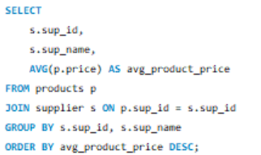
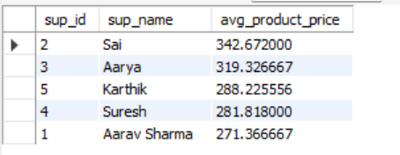
What is the average price of products from each supplier?
QUERY
DESCRIPTION :
This query calculates the average product price for each supplier. It joins products with suppliers, uses AVG(price) to find the mean price of products per supplier, groups the results by supplier, and orders them from highest to lowest average price.
OUTPUT

Slide 26
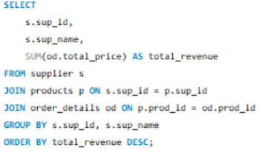
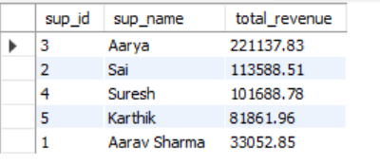
Which suppliers contribute the most to total product sales (by revenue)?
QUERY
DESCRIPTION :
This query identifies the suppliers generating the highest revenue. It joins suppliers with products and order details, sums up the total sales (SUM(total_price)) for each supplier, groups the results by supplier, and orders them in descending order of revenue.
OUTPUT

Slide 27
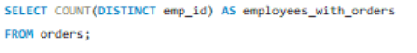
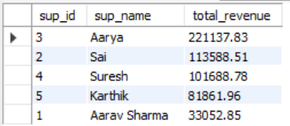
Employee Performance
How many employees have processed orders?
QUERY
DESCRIPTION :
This query returns the number of unique employees who have processed orders by counting distinct emp_id values from the orders table.
OUTPUT

Slide 28
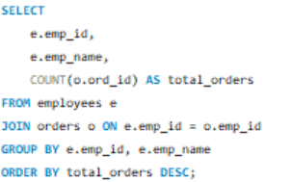
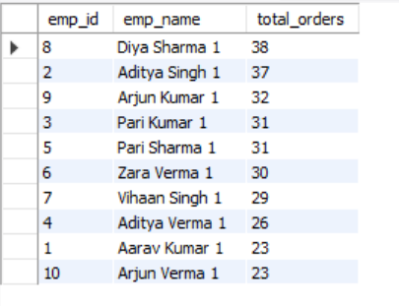
Which employees have handled the most orders?
QUERY
DESCRIPTION :
This query identifies the employees who have handled the most orders. It joins employees with orders, counts the orders per employee, groups by employee, and orders the results in descending order of total orders.
OUTPUT

Slide 29
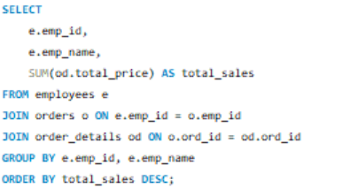
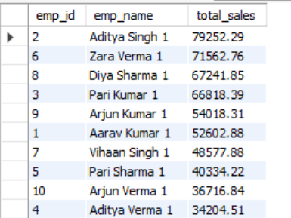
What is the total sales value processed by each employee?
QUERY
DESCRIPTION :
This query calculates the total sales value processed by each employee. It joins employees with orders and order details, sums up the total_price for all orders handled by each employee, groups the results by employee, and orders them from highest to lowest sales.
OUTPUT

Slide 30


What is the average order value handled per employee?
QUERY
DESCRIPTION :
This query calculates the average order value handled by each employee. It sums the total sales per employee and divides by the number of orders they processed, rounding the result to two decimal places, then orders employees from highest to lowest average order value.
OUTPUT

Slide 31


Order Details Deep Dive
What is the relationship between quantity ordered and total price?
QUERY
DESCRIPTION :
This query shows the relationship between quantity ordered and total price. It groups orders by quantity, calculates the average total price for each quantity, and orders the results to reveal how increasing order quantities affect the total price.
OUTPUT

Slide 32


What is the average quantity ordered per product?
QUERY
DESCRIPTION :
This query calculates the average quantity ordered for each product. It joins order details with products, computes the average quantity using AVG(quantity), groups results by product, and orders them from highest to lowest average quantity.
OUTPUT

Slide 33




How does the unit price vary across products and orders?
QUERY
DESCRIPTION :
The first query shows the price variation for each product, including the minimum, maximum, and average price across all orders, helping understand product pricing trends.
The second query provides the price statistics per order, including the number of distinct products, minimum, maximum, and average price within each order, highlighting how order composition affects pricing.
OUTPUT

Slide 34

Key insights
Few customers & products contribute most of the revenue.
Top 5 customers = major share of sales → loyalty programs needed.
Some suppliers dominate in product availability & revenue.
Sales peak on weekends & certain months (seasonal trends).
Fast-moving products drive high order volumes.
Employee performance impacts total sales handled.

Slide 35

Recommendations
Introduce loyalty programs for top customers
Keep fast-moving products always in stock
Run seasonal and weekend offers to boost sales
Strengthen ties with key suppliers
Reward and train employees based on performance
Offer bulk purchase discounts to increase revenue

Slide 36

To conclude, the Grocery Store Management System successfully demonstrates how SQL and data analytics can be applied to real-world problems.
The project helped me strengthen my skills in database design, writing queries, and extracting insights for business growth.
The key takeaway is that even a small database, when properly structured, can generate meaningful insights for decision-making.

Slide 37


Slide 38

THANK YOU

